Slide 1


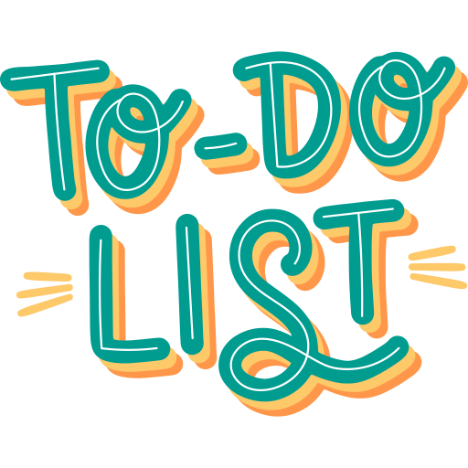

TEAM MEMBERS:
Madhamshetty Sravani (TL)
Sneha Shekhar
Anjali Myadogani
Macherla Bhargavi
Nishath Tanveer

Slide 2
Project Description
About:
To do list application allows the user to keep a record of the tasks that need to be done in a specific time frame. It’s a list of tasks you need to complete or things that you want to do. Most typically, they’re organized in order of priority. Traditionally, they’re written on a piece of paper or post it notes and act as a memory aid. As technology has evolved we have been able to create a to do lists digitally with advanced tools. You can use a to do list in your home and personal life, or in the workplace.

Slide 3
Benefits:
Better time management. Less stress to remember things.
Tasks are easy to add and organize
Lesser chance of missing something important as it is stored as a record.
Accessible anywhere with internet
Helps to set a time frame for a plan and can be seen through visual indicators provided.
Get notified through email as soon as a task is added.
Manage the status of the task and update anytime.

Slide 4


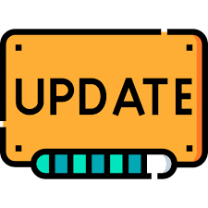


APPLICATION FEATURES
Allows user to permanently keep task records with a user account.
User gets notification via email once she/he adds a task. Email contains the information about Task name and dates assigned to it.
User can modify the task status and dates. One can also delete the tasks.
Keeps the tasks time bounded.

Slide 5
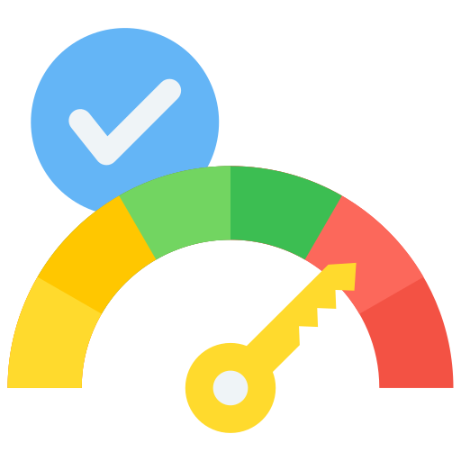
APPLICATION FEATURES
Visual indicators for tasks which will clearly show user the status of the task added and can help user organize and plan accordingly.
YET IN COMPLETED DUE
TO START PROGRESS DATE CROSSED
___The above colours showing the status___

Slide 6


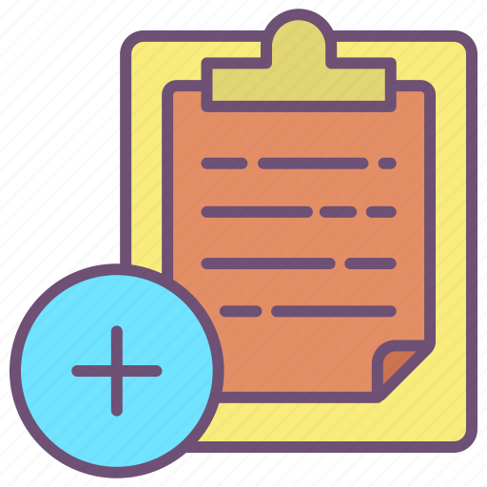

PARAMETERS OF TASK
TASK DURATION
(Start Date – End Date)
STATUS OF TASKS
TASK NAME

Slide 7
USER FUNCTIONALITIES
User should register themselves in the application.
User can ADD Task according to their requirement.
User can UPDATE Tasks with changed durations.
User can DELETE the Tasks.
User can view all the Tasks at a time which was assigned by her/him.
User will be able to get a notification mail after adding a task which will show the dates assigned to the task and it’s name.

Slide 8
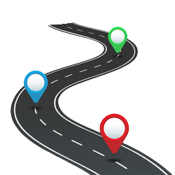
PROJECT ROADMAP
UI WITH JSP
IMPLEMENTATION USING DAO LAYER & REPOSITORIES
JAVA

Slide 9


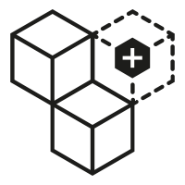
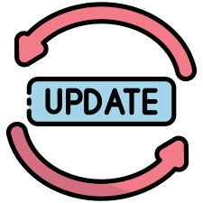

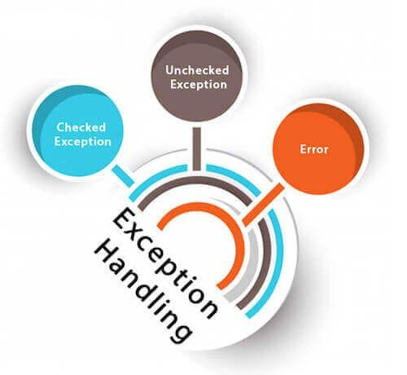
PROJECT MODULE
AUTHENTICATION NOTIFICATION USING
MAIL MODULE
ADDING TASK MODULE UPDATING TASK MODULE
VIEW ALL TASKS EXCEPTIONAL
HANDLING

Slide 10
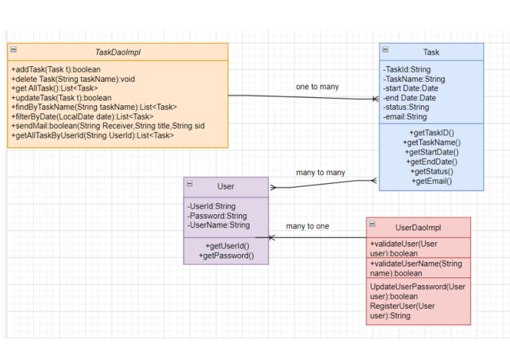
CLASS DIAGRAM

Slide 11
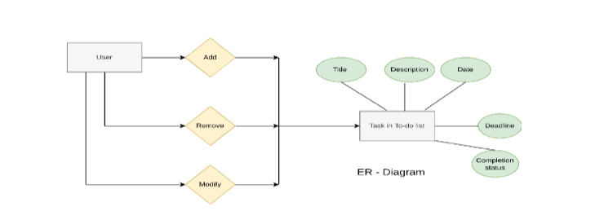
ER - DIAGRAM

Slide 12
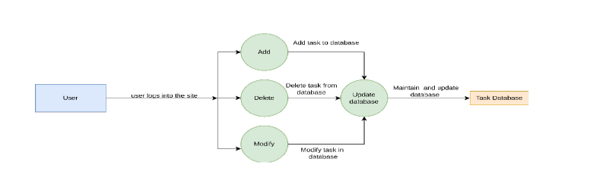
DATA FLOW DIAGRAM

Slide 13
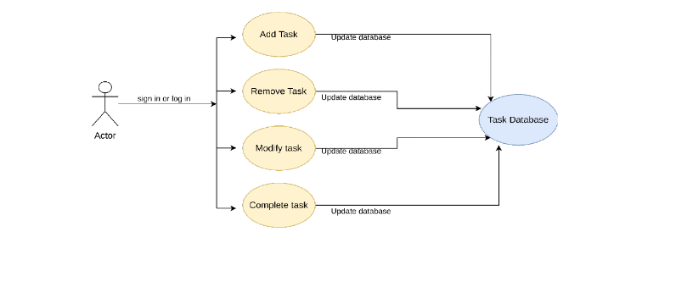
USE CASE DIAGRAM

Slide 14
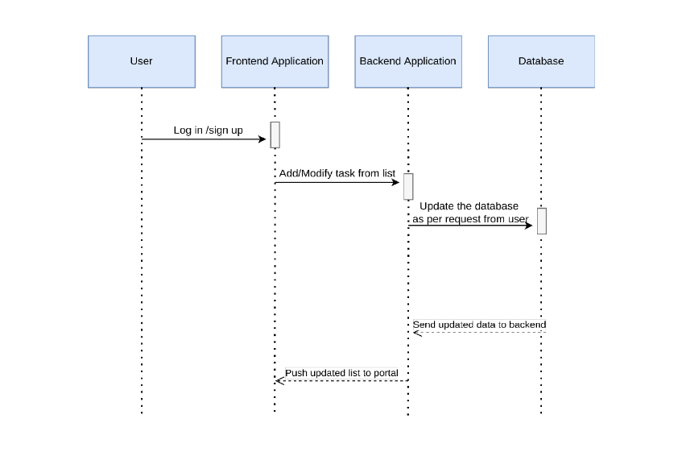
GRAPHICAL ABSTRACT

Slide 15
FUTURE SCOPE
Users can receive reminder notification before due dates.
SOCIAL MEDIA INTEGRATION:
Integrate social media profiles to gain a comprehensive view of tasks and appilcation. Evaluate online presence and alignment with tasks.

Slide 16
CONCLUSION:
To do list always used to be something that you would write using pen and paper, but thanks to technology there’s an app that can come to the rescue. With the application built using JSP servlet technology you can set priorities, plan and manage work, get reminded for any self-imposed deadlines by adding tasks, search for tasks and check the status and also update it.
All it takes is just a few minutes every day to keep a to do list up to date. With a to do list, you can complete goals without wasting time trying to figure out priorities. Your productivity will increase, you won’t forget things, your time management will improve and you’ll be able to manage your tasks more effectively.

Slide 17

Thanks to:
CENTUM FOUNDATION

